Slide 1

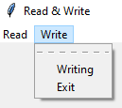

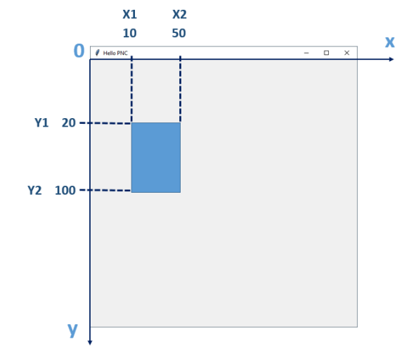
RANDOM
DRAW IMAGE
ANIMATION : MOVE A BALL
CREATE MENU
import random
numbers = [5,9,6,1]
# Select a number in the list
anyOnArray = random.choice(numbers))
# Select a number btw 10 and 20
anyOnRange = random.randint(10, 20)
def moveBall():
global x
x+ =1
canvas.moveTo(ball,x, y)
# call again after 1 sec
canvas.after(1000, lambda:moveBall())
x = 0
y = 0
# create the ball and keep the id
ball = canvas.create_oval(x, y, x2, y2)
moveBall()
def onClick():
print("Do something")
# Create the root menu
root_menu = Menu(root)
root.config(menu=root_menu)
# Add a menu item and bind to a function
root_menu.add_command(label="Read", command= onClick)
# Load the image
myImage = tk.PhotoImage(file='.\myImage.gif')
# Add the image to the canvas
myImageId = canvas.create_image(100, 100, image=myImage)
WINDOW
import tkinter as tk
window = tk.Tk()
# Create window width = 600px height = 200 px
window.geometry("600x600")
# Create a canvas on this window
canvas = tk.Canvas(window)
MOVE / CHANGE PROPERTIES
PLAY MUSIC
rectangleId = canvas.create_rectangle(x1, y1, x2, y2)
# Move at position 40, 40
canvas.moveTo(rectangleId,40, 40)
# Change the fill color
canvas.itemconfig(rectangleId, fill='red')
CREATE BUTTON
# Load the library for sounds
import winsound
# Play the sound winsound .PlaySound("test.wav",
winsound.SND_FILENAME)
def onClick():
print("Do something")
# create a button
button = tk.Button(root, text=“CLICK", command=onClick)
button.pack()
DRAW SHAPES
canvas = tk.Canvas(root)
canvas.create_rectangle(x1, y1, x2, y2)
canvas.create_oval(x1, y1, x2, y2, fill="#FFFF00“)
canvas.create_line(x1, y1, x2, y2, fill="red")
canvas.create_text(x1, y1, text="Just do it")
KEYBOARD & MOUSE EVENT
CLEAR CANVAS
# bind the up key to the function moveUP
root.bind("up", moveUp)
# Define the function moveUp
def moveUp(event) :
print(“test”)
canvas.delete("all")
READ / WRITE FILES
# Write on file
file = open('para.txt','a')
file.write("\n" + text.get())
file.close()
KEY | Meaning
Up / Down / Left /Right | Arrows keys
<Button-1> | Mouse LEFT click
<Button-2> | Mouse MIDDLE click
<Button-3> | Mouse RIGHT click
Return | Enter key
Backspace | Backspace key
GOOD LINKS !!!
# Read a file
file = open('text.txt','r’)
# Add text in a string
text = file.read()
# Text in a array, line by line
text = file.read()
file.close()
USER GUIDE TO TKINTER

Slide 2
Simplification rules to know
Note: ! A means : not A
IDENTITY
DE MORGAN
FACTORISATION
A and True = A
!( A or B) = !A and !B
(A and B) or A
= A and ( B or True)
A or False = A
!( A and B) = !A or !B
ABSORTION
IDEMPOTENCE
DOUBLE COMPLEMENT
A and False = False
A and A and A = A
!( !A) = A
A or True = True
A or A or A = A
CONTRADICTION
COMMUTATIVIY
DISTRIBUTIVITY
A and !A = False
A and (B or C) = (A and B) or (A and C)
A or (B and C) = (A or B) and (A or C)
A or B = B or A
A or !A = True

